Slide 1
WEB TECHNOLOGY LABORATORY WITH MINI PROJECT
(15CSL77)

Slide 2
Write a JavaScript to design a simple calculator to perform the following operations: sum, product, difference and quotient.

Slide 3
Program 1 - JavaScript : Simple calculator
<!DOCTYPE HTML>
<html>
<head>
<style>
table, td, th
{
border: 1px solid black;
width: 33%;
text-align: center;
background-color: DarkGray;
border-collapse:collapse;
}
table { margin: auto; }
input { text-align:right; }
</style>

Slide 4
<script type="text/javascript">
function calc(clicked_id)
{
var val1 = parseFloat(document.getElementById("value1").value);
var val2 = parseFloat(document.getElementById("value2").value);
if(isNaN(val1)||isNaN(val2))
alert("ENTER VALID NUMBER");
else if(clicked_id=="add")
document.getElementById("answer").value=val1+val2;
else if(clicked_id=="sub")
document.getElementById("answer").value=val1-val2;
else if(clicked_id=="mul")
document.getElementById("answer").value=val1*val2;

Slide 5
else if(clicked_id=="div")
document.getElementById("answer").value=val1/val2;
}
function cls()
{
value1.value=" ";
value2.value=" ";
answer.value="";
}
</script>
</head>
<body>

Slide 6
<table>
<tr><th colspan="4"> SIMPLE CALCULATOR </th></tr>
<tr><td>value1</td><td><input type="text" id="value1" value=" "/> </td>
<td>value2</td><td><input type="text" id="value2" value=" "/> </td> </tr>
<tr> <td> <input type="button" value="Addition" id = "add" onclick="calc(this.id)"/></td>
<td> <input type="button" value="Subtraction" id = "sub" onclick="calc(this.id)"/></td>
<td> <input type="button" value="Multiplication" id = "mul" onclick="calc(this.id)"/></td>
<td> <input type="button" value="Division" id ="div" onclick="calc(this.id)"/></td></tr>
<tr> <td>Answer:</td> <td> <input type="text" id="answer" value="" disabled/></td>
<td colspan="2"><input type="button" value="CLEAR ALL" onclick="cls()"/></td>
</tr>
</table>
</body>
</html>

Slide 7



Program 1 - JavaScript : Simple calculator – OUTPUT:

Slide 8
2. Write a JavaScript that calculates the squares and cubes of the
numbers from 0 to 10 and outputs HTML text that displays the
resulting values in an HTML table format.

Slide 9
Program 2 - JavaScript : Calculate squares and cubes of the
numbers from 0 to 10
<!DOCTYPE HTML>
<html>
<head>
<style>
table,tr, td
{
border: solid black;
width: 33%;
text-align: center;
border-collapse: collapse;
background-color:lightblue;
}
table { margin: auto; }
</style>

Slide 10
<script>
document.write( "<table> <tr><th colspan='3'> NUMBERS FROM 0 TO 10
WITH THEIR SQUARES AND CUBES </th></tr>" );
document.write( "<tr> <td>Number</td> <td>Square</td> <td>Cube</td>
</tr>" );
for(var n=0; n<=10; n++)
{
document.write( "<tr><td>" + n + "</td><td>" + n*n + "</td><td>"
+ n*n*n + "</td></tr>" ) ;
}
document.write( "</table>" ) ;
</script>
</head>
</html>

Slide 11
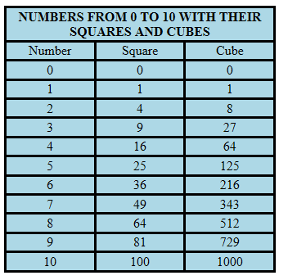
Program 2 - JavaScript : Calculate squares and cubes of the
numbers from 0 to 10 - OUTPUT

Slide 12
3. Write a JavaScript code that displays text “TEXT-GR OWING”
with increasing font size in the interval of 100ms in RED
COLOR, when the font size reaches 50pt it displays “TEXT-
SHRINKING” in BLUE color. Then the font size decreases to 5pt.

Slide 13
Program 3 - JavaScript : TEXT-GROWING and TEXT-SHRINKING
<!DOCTYPE HTML>
<html>
<head>
<style>
p
{ position: absolute;
top: 50%;
left: 50%;
transform: translate(-50%, -50%);
}
</style>
</head>
<body>
<p id="demo"></p>
<script>
var var1 = setInterval(inTimer, 1000);
var fs = 5;
var ids = document.getElementById("demo");

Slide 14
function inTimer()
{ ids.innerHTML = 'TEXT GROWING';
ids.setAttribute('style', "font-size: " + fs + "px; color: red");
fs += 5;
if(fs >= 50 )
{
clearInterval(var1);
var2 = setInterval(deTimer, 1000);
}
}

Slide 15
function deTimer()
{
fs -= 5;
ids.innerHTML = 'TEXT SHRINKING';
ids.setAttribute('style', "font-size: " + fs + "px; color: blue");
if(fs === 5 )
{
clearInterval(var2);
}
}
</script>
</body>
</html>

Slide 16
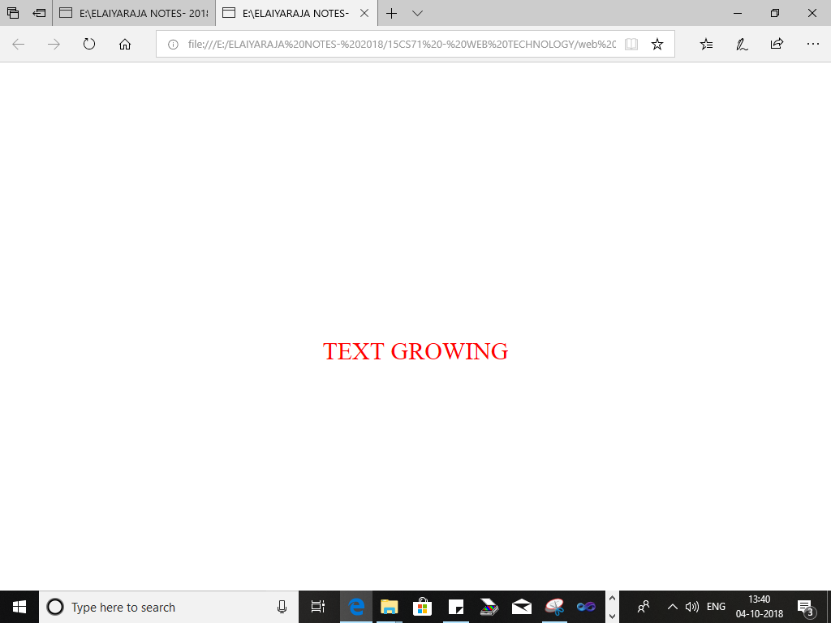
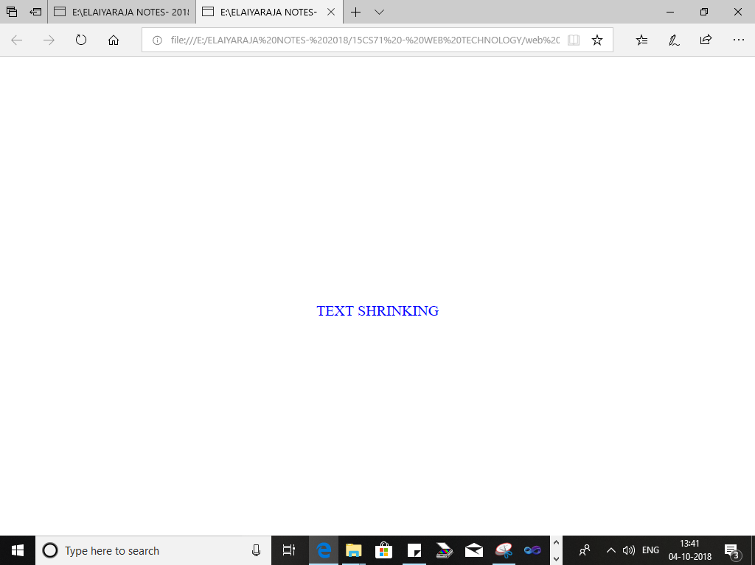
Program 3 - JavaScript : TEXT-GROWING and TEXT-SHRINKING
OUTPUT

Slide 17
4. Develop and demonstrate a HTML5 file that includes
JavaScript script that uses functions for the following
problems:
a. Parameter: A string
b. Output: The position in the string of the left-most vowel
c. Parameter: A number
d. Output: The number with its digits in the reverse order

Slide 18
Program 4 - HTML5 and JavaScript :
a) position in the string of the left-most vowel
b) number with its digits in the reverse order
<!DOCTYPE HTML>
<html>
<body>
<script type="text/javascript">
var str = prompt("Enter the Input","");
if(!(isNaN(str)))
{
var num,rev=0,remainder;
num = parseInt(str);

Slide 19
while(num!=0) {
remainder = num%10;
num = parseInt(num/10);
rev = rev * 10 + remainder;
}
alert("Reverse of "+str+" is "+rev);
}
else
{
str = str.toUpperCase();
for(var i = 0; i < str.length; i++) {
var chr = str.charAt(i);
if(chr == 'A' || chr == 'E' || chr == 'I' || chr == 'O' || chr == 'U')break;
}

Slide 20
if( i < str.length )
alert("The position of the left most vowel is "+(i+1));
else
alert("No vowel found in the entered string");
}
</script>
</body>
</html>

Slide 21
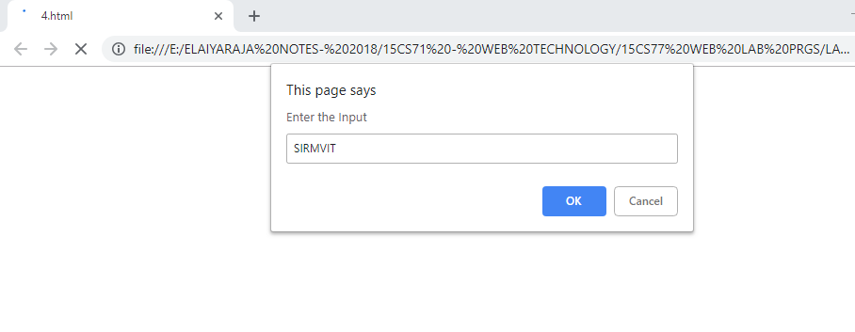
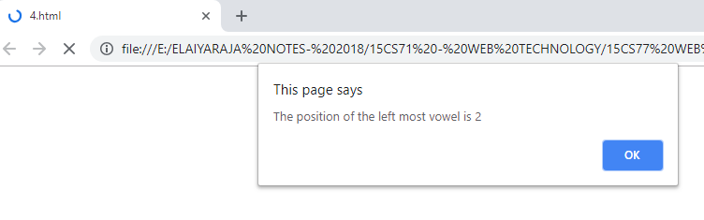
Program 4 - HTML5 and JavaScript :
a) position in the string of the left-most vowel
b) number with its digits in the reverse order
OUTPUT :

Slide 22
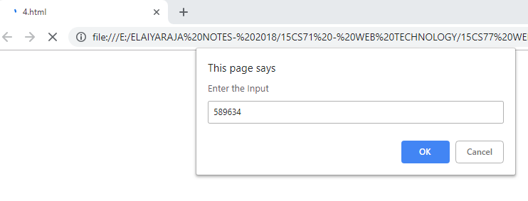
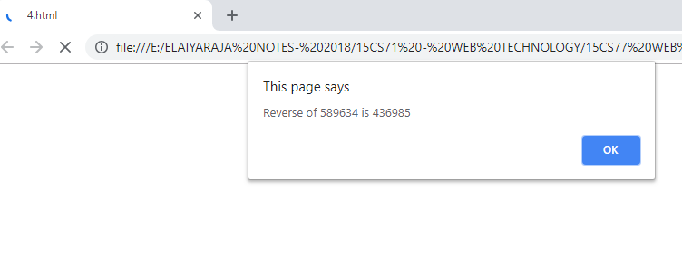

Slide 23
5. Design an XML document to store information about a student
in an engineering college affiliated to VTU. The information
must include USN, Name, and Name of the College, Branch,
Year of Joining, and email id. Make up sample data for 3
students. Create a CSS style sheet and use it to display the
document.

Slide 24
Program 5 - XML document to store information about a student .

Slide 25
href="5.css“ //CREATE CSS FILE
student
{
display:block; margin-top:10px; color:Navy;
}
USN
{
display:block; margin-left:10px;font-size:14pt; color:Red;
}
name
{
display:block; margin-left:20px;font-size:14pt; color:Blue;
}
college
{
display:block; margin-left:20px;font-size:12pt; color:Maroon;
}

Slide 26
branch
{
display:block; margin-left:20px;font-size:12pt; color:Purple;
}
year
{
display:block; margin-left:20px;font-size:14pt; color:Green;
}
e-mail
{
display:block; margin-left:20px;font-size:12pt; color:Blue;
}
// SAVE CSS FILE

Slide 27
<?xml-stylesheet type="text/css" href="5.css" ?> // REFERENCE CSS FILE
<!DOCTYPE HTML>
<html>
<head>
<h1> STUDENTS DETAILS </h1>
</head>
<students>
<student>
<USN>USN : 1MV16CS021</USN>
<name>NAME : VENKAT</name>
<college>COLLEGE: SIRMVIT</college>
<branch>BRANCH : Computer Science and Engineering</branch>
<year>YEAR : 2016</year>
<e-mail>E-Mail : venkat@gmail.com</e-mail>
</student>

Slide 28
<student>
<USN>USN : 1MV11IS031</USN>
<name>NAME : ADITYA</name>
<college>COLLEGE: SIRMVIT </college>
<branch>BRANCH : Information Science and Engineering</branch>
<year>YEAR : 2011</year>
<e-mail>E-Mail : aditya@gmail.com</e-mail>
</student>

Slide 29
<student>
<USN>USN : 1MV15ME044</USN>
<name>NAME : DEVARAJA</name>
<college>COLLEGE: SIRMVIT </college>
<branch>BRANCH : Mechanical and Engineering</branch>
<year>YEAR : 2015</year>
<e-mail>E-Mail : devaraja@gmail.com</e-mail>
</student>
</students>
</html>

Slide 30
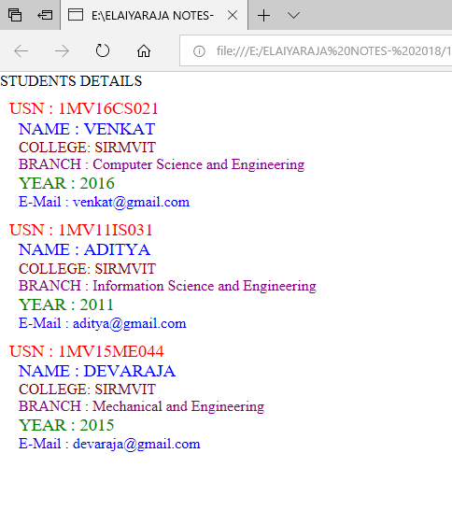
Program 5 - XML document to store information about a student
OUTPUT:

Slide 31
WEB TECHNOLOGY AND ITS APPLICATIONS LABORATORY (15CSL77)
PROGRAMS 6 TO 10

Slide 32
STEP1: DOWNLOAD XAMPP VERSION (32 bit or 64 bit)
STEP2 : RIGHT CLICK ON XAMPP APPLICATION AND RIGHT CLICK RUN AS ADMINISTRATOR

Slide 33
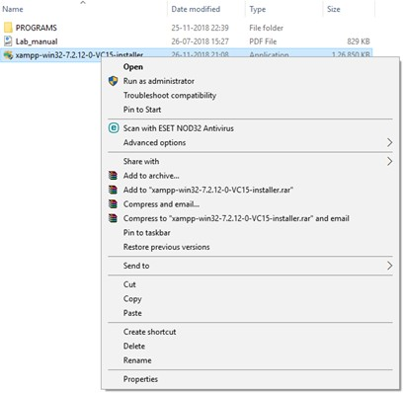

Slide 34
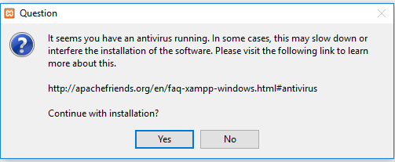

Slide 35
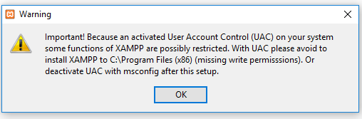

Slide 36
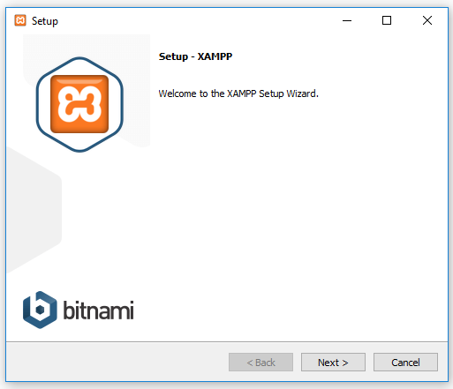

Slide 37
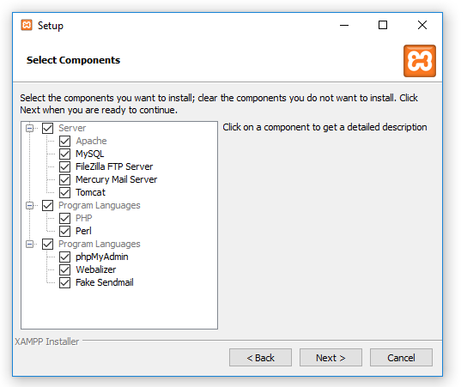

Slide 38
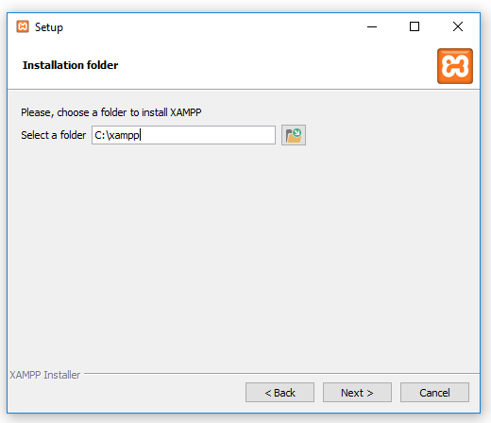

Slide 39
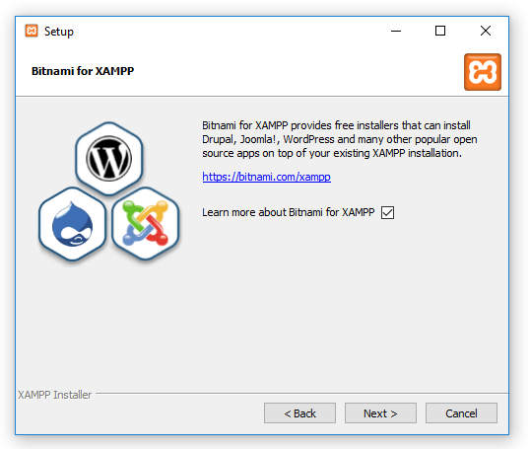

Slide 40
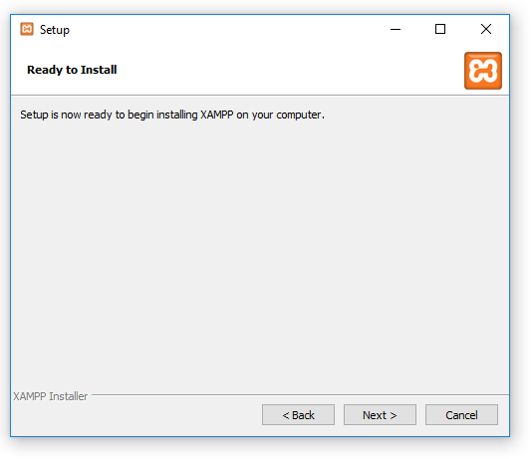

Slide 41
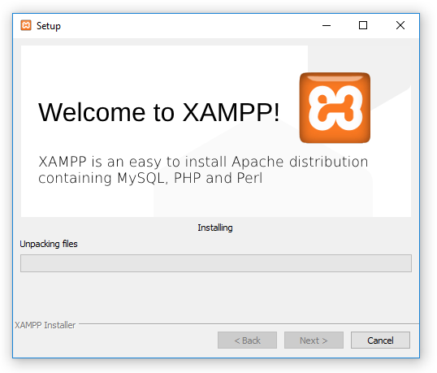

Slide 42


Slide 43
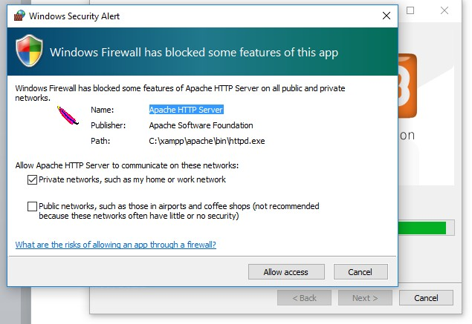

Slide 44
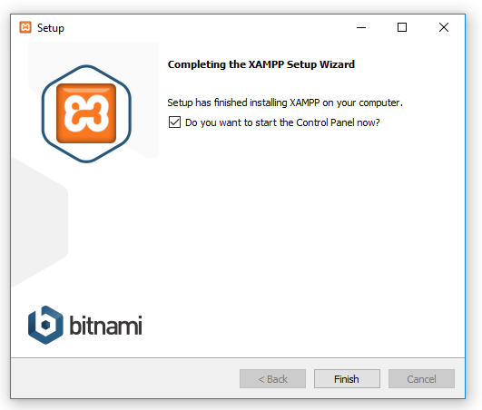

Slide 45
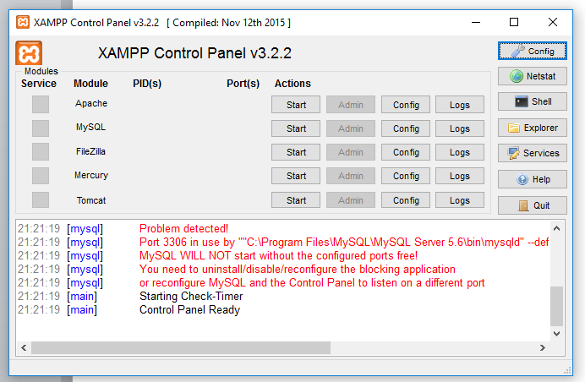

Slide 46
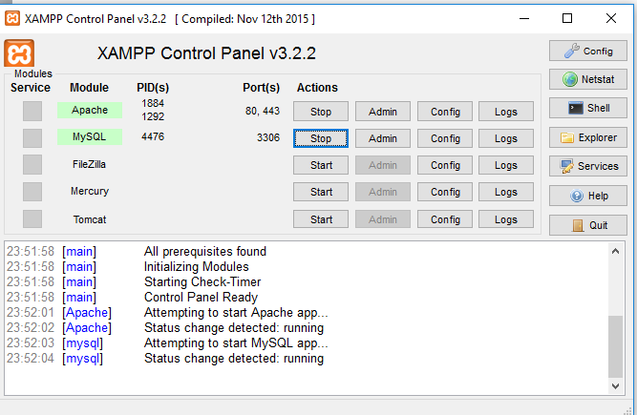

Slide 47
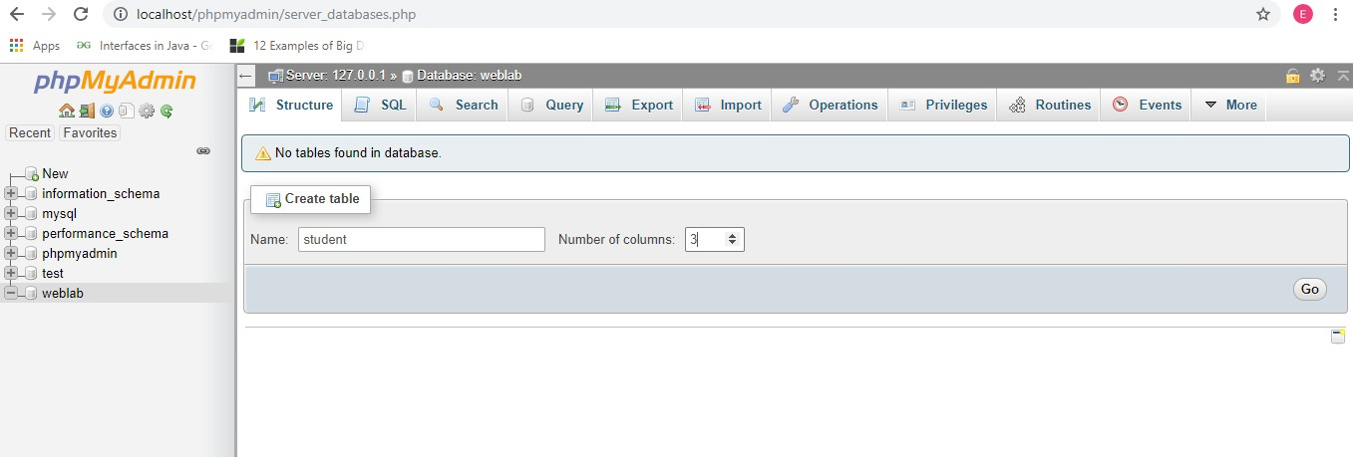

Slide 48
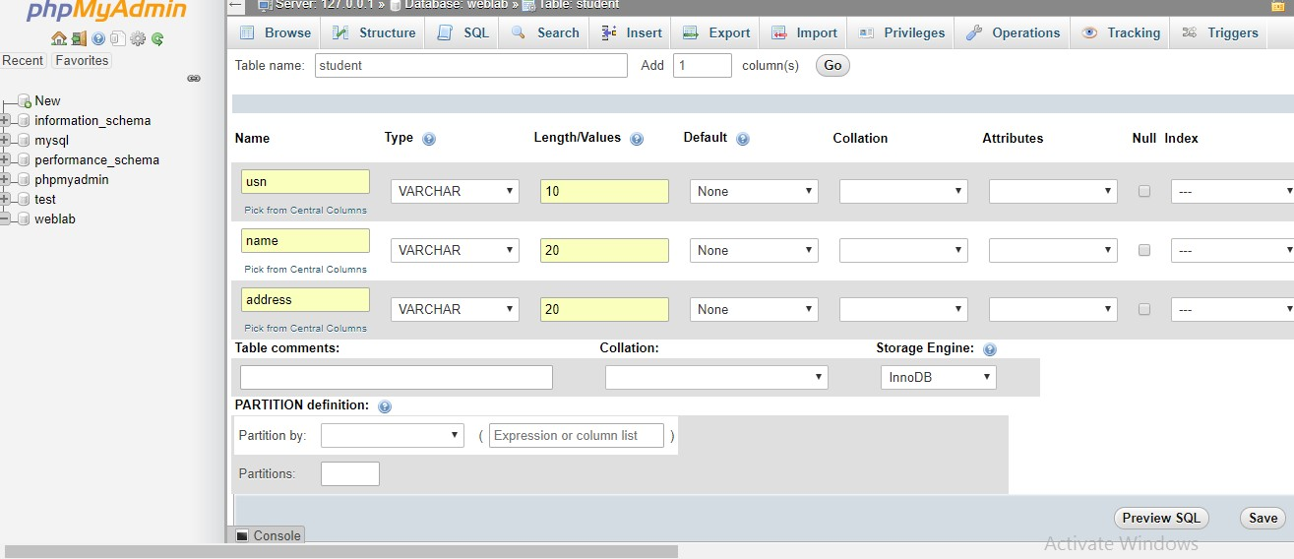

Slide 49
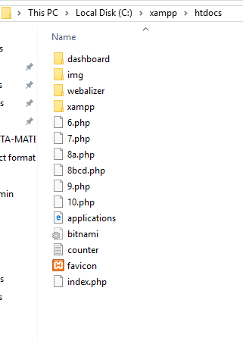

Slide 50
6. Write a PHP program to keep track of the number of visitors visiting the web page and to display this count of visitors, with proper headings.

Slide 51
<?php
print "<h3> REFRESH PAGE </h3>";
$name="counter.txt";
$file = fopen($name,"r");
$hits= fscanf($file,"%d");
fclose($file);
$hits[0]++;
$file = fopen($name,"w");
fprintf($file,"%d",$hits[0]);
fclose($file);
print "Total number of views: ".$hits[0];
?>

Slide 52
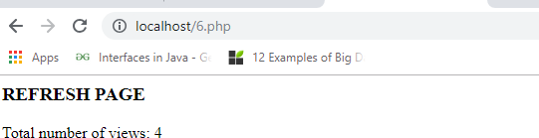
Output:

Slide 53
7. Write a PHP program to display a digital clock which displays the current time of the server.

Slide 54
<!DOCTYPE HTML>
<html>
<head>
<meta http-equiv="refresh" content="1"/>
<style> p {
color:white; font-size:90px;
position: absolute;
top: 50%;
left: 50%;
transform: translate(-50%, -50%);
}
body{background-color:black;}
</style>
<p> <?php echo date(" h: i : s A");?> </p>
</head>

Slide 55
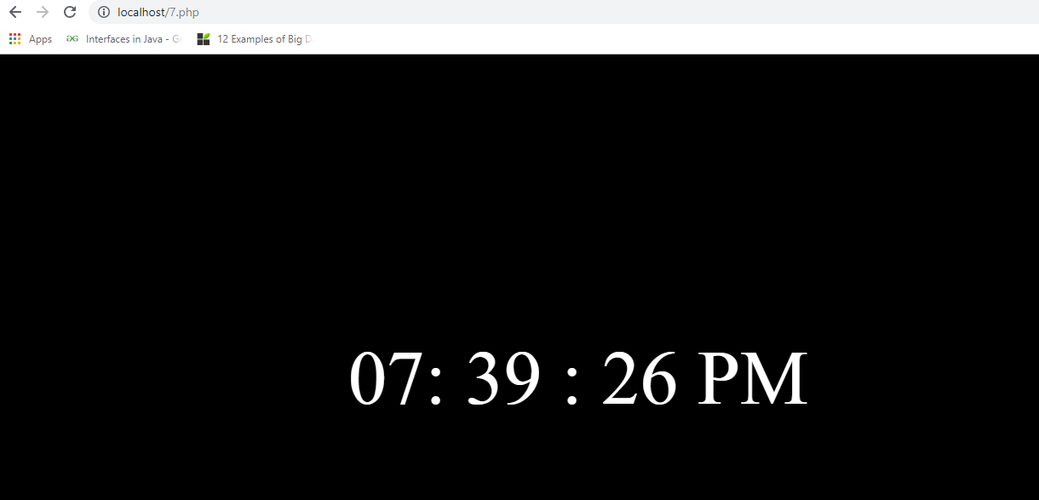
Output:

Slide 56
8. Write the PHP programs to do the following:
Implement simple calculator operations.
Find the transpose of a matrix.
Multiplication of two matrices.
Addition of two matrices.

Slide 57
<html>
<head>
<style>
table, td, th
{
border: 1px solid black;
width: 35%;
text-align: center; background-color: DarkGray;
}
table { margin: auto; } input,p { text-align:right; }
</style>
</head>

Slide 58
<body>
<form method="post">
<table>
<caption><h2> SIMPLE CALCULATOR </h2></caption>>
<tr><td>First Number:</td><td><input type="text" name="num1" /></td>
<td rowspan="2"><input type="submit" name="submit" value="calculate"></td></tr>
<tr><td>Second Number:</td><td><input type="text" name="num2"/></td></tr>
</form>

Slide 59
<?php
if(isset($_POST['submit'])) // it checks if the input submit is filled
{
$num1 = $_POST['num1'];
$num2 = $_POST['num2']; if(is_numeric($num1) andis_numeric($num1) )
{
echo "<tr><td> Addition :</td><td><p>".($num1+$num2)."</p></td>"; echo "<tr><td> Subtraction :</td><td><p> ".($num1-$num2)."</p></td>";
echo "<tr><td> Multiplication :</td><td><p>".($num1*$num2)."</p></td>"; echo "<tr><td>Division :</td><td><p> ".($num1/$num2)."</p></td>";
echo "</table>";
}

Slide 60
else
{
echo"<script type='text/javascript' > alert(' ENTER VALID NUMBER');
</script>";
}
}
?>
</body>
</html>

Slide 61
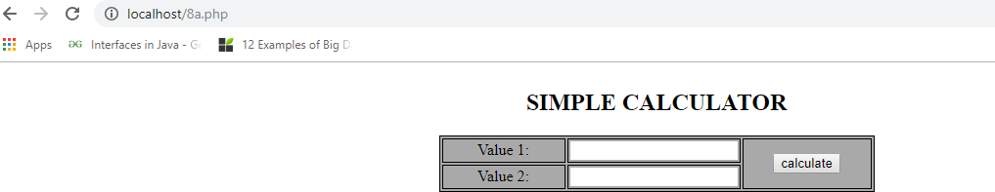
Output:

Slide 62
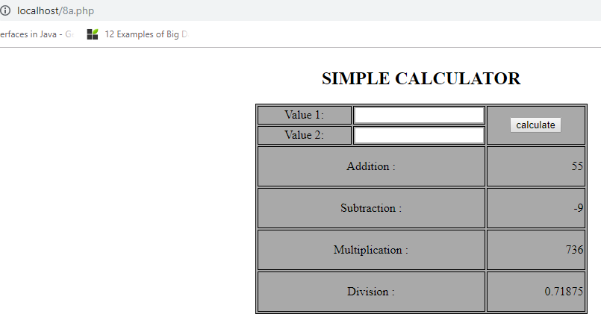
Output:

Slide 63
8bcd.php
<?php
$a = array(array(1,2,3),array(4,5,6),array(7,8,9));
$b = array(array(7,8,9),array(4,5,6),array(1,2,3));
$m=count($a);
$n=count($a[2]);
$p=count($b);
$q=count($b[2]);
echo "the first matrix :"."<br/>"; for ($row = 0; $row < $m; $row++) { for ($col = 0; $col < $n; $col++)
echo " ".$a[$row][$col]; echo "<br/>";
}

Slide 64
echo "the second matrix :"."<br/>"; for ($row = 0; $row < $p; $row++) { for ($col = 0; $col < $q; $col++)
echo " ".$b[$row][$col]; echo "<br/>";
}
echo "the transpose for the first matrix is:"."<br/>"; for ($row = 0; $row < $m; $row++) {
for ($col = 0; $col < $n; $col++)
echo " ".$a[$col][$row]; echo "<br/>";
}

Slide 65
if(($m===$p) and ($n===$q)) {
echo "the addition of matrices is:"."<br/>"; for ($row = 0; $row < 3; $row++) {
for ($col = 0; $col < 3; $col++)
echo " ".$a[$row][$col]+$b[$row][$col]." "; echo "<br/>";
} }
if($n===$p){
echo " The multiplication of matrices: <br/>";
$result=array();
for ($i=0; $i < $m; $i++) { for($j=0; $j < $q; $j++){
$result[$i][$j] = 0;
for($k=0; $k < $n; $k++)
$result[$i][$j] += $a[$i][$k] * $b[$k][$j];
} }

Slide 66
for ($row = 0; $row < $m; $row++)
{
for ($col = 0; $col < $q; $col++) echo " ".$result[$row][$col]; echo "<br/>";
}
}
?>

Slide 67
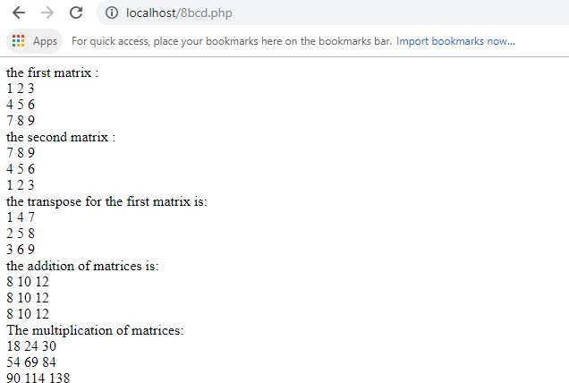
Output:

Slide 68
9. Write a PHP program named states.py that declares a variable states with value "Mississippi Alabama Texas Massachusetts Kansas". write a PHP program that does the following:
Search for a word in variable states that ends in xas. Store this word in element 0 of a list named states List.
Search for a word in states that begins with k and ends in s. Perform a case-insensitive comparison. [Note: Passing re.Ias a second parameter to method compile performs a case-insensitive comparison.] Store this word in element1 of states List.
Search for a word in states that begins with M and ends in s. Store this word in element 2 of the list.
Search for a word in states that ends in a. Store this word in element 3 of
the list.

Slide 69
<?php
$states = "Mississippi Alabama Texas Massachusetts Kansas";
$statesArray = [];
$states1 = explode(' ',$states); echo "Original Array :<br>"; foreach ( $states1 as $i => $value ) print("STATES[$i]=$value<br>"); foreach($states1 as $state)
{
if(preg_match( '/xas$/', ($state)))
$statesArray[0] = ($state);
}

Slide 70
foreach($states1 as $state) { if(preg_match('/^k.*s$/i', ($state)))
$statesArray[1] = ($state);
}
foreach($states1 as $state) {
if(preg_match('/^M.*s$/', ($state)))
$statesArray[2] = ($state);
}

Slide 71
foreach($states1 as $state){ if(preg_match('/a$/', ($state)))
$statesArray[3] = ($state);
}
echo "<br><br>Resultant Array :<br>"; foreach ( $statesArray as $array => $value )
print("STATES[$array]=$value<br>");
?>

Slide 72
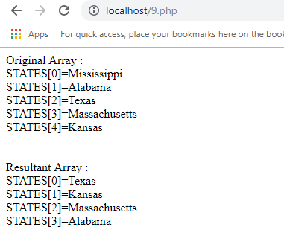
Output:

Slide 73
10. Write a PHP program to sort the student records which are stored in the database using selection sort.

Slide 74
Goto Mysql and then type create database weblab; use weblab;
create table student(usnvarchar(10),name varchar(20),address
varchar(20));

Slide 75
<!DOCTYPE html>
<html>
<body>
<style> table, td, th
{
border: 1px solid black; width: 33%;
text-align: center; border-collapse:collapse;
background-color:lightblue;
}
table { margin: auto; }
</style>
<?php

Slide 76
$servername = "localhost";
$username = "root";
$password = "root";
$dbname = "weblab";
$a=[];
// Create connection
// Opens a new connection to the MySQL server
$conn = mysqli_connect($servername, $username, $password, $dbname);

Slide 77
// Check connection and return an error description from the last connection error, if any
if ($conn->connect_error)
die("Connection failed: " . $conn->connect_error);
$sql = "SELECT * FROM student";
// performs a query against the database
$result = $conn->query($sql); echo "<br>";
echo "<center> BEFORE SORTING </center>"; echo "<table border='2'>";
echo "<tr>";
echo "<th>USN</th><th>NAME</th><th>Address</th></tr>"; if ($result->num_rows> 0)
{

Slide 78
// output data of each row and fetches a result row as an associative array
while($row = $result->fetch_assoc()) {
echo "<tr>";
echo "<td>". $row["usn"]."</td>";
echo "<td>". $row["name"]."</td>"; echo "<td>". $row["addr"]."</td></tr>"; array_push($a,$row["usn"]);
} }
else
echo "Table is Empty";
echo "</table>";
$n=count($a);
$b=$a;
for ( $i = 0 ; $i< ($n - 1) ; $i++ )
{
$pos= $i;

Slide 79
for ( $j = $i + 1 ; $j < $n ; $j++ ) { if ( $a[$pos] > $a[$j] )
$pos= $j;
}
if ( $pos!= $i ) {
$temp=$a[$i];
$a[$i] = $a[$pos];
$a[$pos] = $temp;
}
}
$c=[];
$d=[];
$result = $conn->query($sql);
if ($result->num_rows> 0)// output data of each row

Slide 80
{
while($row = $result->fetch_assoc()) {
for($i=0;$i<$n;$i++) {
if($row["usn"]== $a[$i]) {
$c[$i]=$row["name"];
$d[$i]=$row["addr"];
}
}
}
}

Slide 81
echo "<br>";
echo "<center> AFTER SORTING <center>";
echo "<table border='2'>";
echo "<tr>";
echo "<th>USN</th><th>NAME</th><th>Address</th></tr>";
for($i=0;$i<$n;$i++) {
echo "<tr>";
echo "<td>". $a[$i]."</td>";
echo "<td>". $c[$i]."</td>";

Slide 82
echo "<td>". $d[$i]."</td></tr>";
}
echo "</table>";
$conn->close();
?>
</body>
</html>

Slide 83
Output:
Before sorting
usn | name | address
1MV034 | Suresh | Bangalore
1MV012 | Ramesh | Mangalore
1MV088 | Darshan | Mandya
After sorting
usn | name | address
1MV012 | Ramesh | Mangalore
1MV034 | Suresh | Bangalore
1MV088 | Darshan | Mandya

Slide 84
The End

